Slide 1
Broad Types of Actions
Create a navigable game board.
Planned for Sprint 3.
Populate the game board with objects based on a chosen scenario.
Planned for Sprint 5.
Implement combat logic, allowing for interaction between objects.
Planned for Sprint 6.
Implement basic enemy AI, allowing enemies to interact with the player.
Planned for Sprint 7.

Slide 2
Release Goals

Slide 3
Sprint 1
Product Owner: Billy Loveday
Scrum Master: Dane Reggia
Goals
Set up and practice Unity and C#
Set up collaboration tools
Slack
Trello
Github

Slide 4
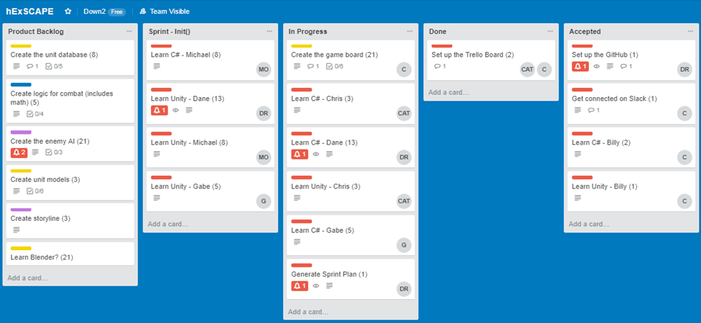
Sprint 1

Slide 5
Sprint 5
Product Owner: Gabe Mayo
Scrum Master: Michael Ouille
Goals
Dane: Movement functionality
Michael: Creating and saving user profiles
Gabe: Combat logic
Billy: Modeling and intro video
Chris: State controller

Slide 6
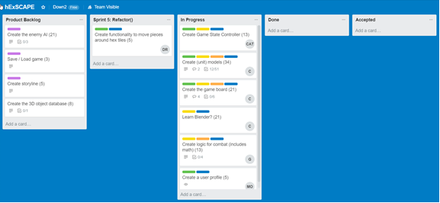
Sprint 5

